Slide 1
CREATING A WEB PROJECT AND CONNECTING TO THE DATABASE

Slide 2
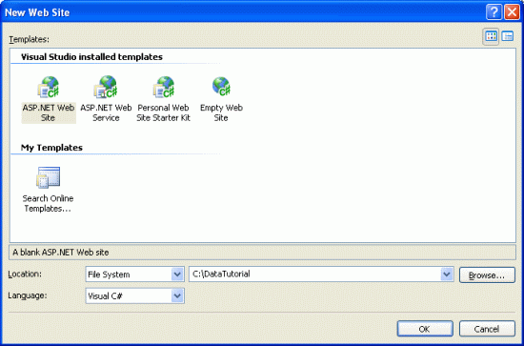
New Project Start

Slide 3
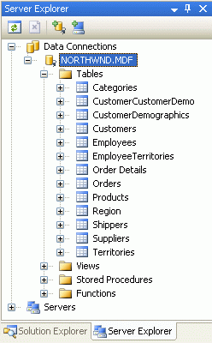
Add a Connection to Your Database Server's Northwind Database

Slide 4
Creating the Data Access Layer
When working with data one option is to embed the data-specific logic directly into the presentation layer (in a web application, the ASP.NET pages make up the presentation layer). This may take the form of writing ADO.NET code in the ASP.NET page's code portion or using the SqlDataSource control from the markup portion. In either case, this approach tightly couples the data access logic with the presentation layer. The recommended approach, however, is to separate the data access logic from the presentation layer. This separate layer is referred to as the Data Access Layer, DAL for short, and is typically implemented as a separate Class Library project. The benefits of this layered architecture are well documented (see the "Further Readings" section at the end of this tutorial for information on these advantages) and is the approach we will take in this series

Slide 5
Methods of DAL
GetCategories(), which will return information about all of the categories
GetProducts(), which will return information about all of the products
GetProductsByCategoryID(categoryID), which will return all products that belong to a specified category
GetProductByProductID(productID), which will return information about a particular product

Slide 6
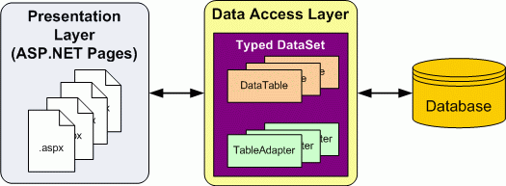

Slide 7
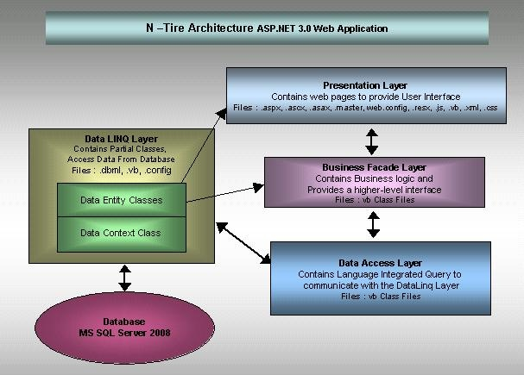

Slide 8
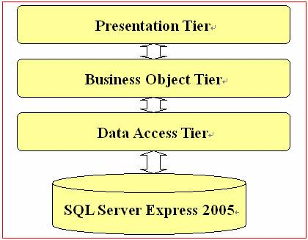

Slide 9
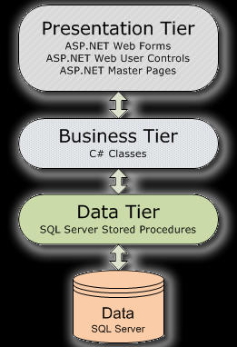

Slide 10
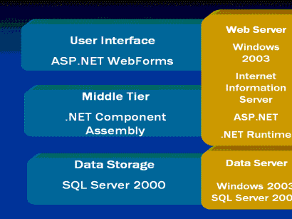

Slide 11
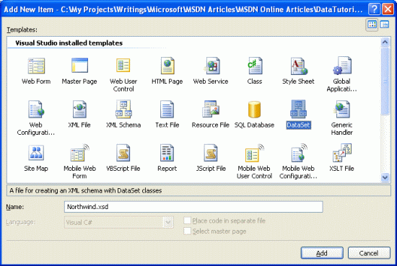
Creating a Typed DataSet and Table Adapter

